Slide 1

Predicting Term Deposit Subscription in Direct Marketing Campaigns
FAIJAS RAHMAN K
Data Analyst

Slide 2
Plan of talk

Slide 3
OBJECTIVE
Analyze customer data from a bank marketing campaign.
Develop a machine learning model to predict term deposit subscriptions.
Perform data cleaning, EDA , and model training .
Support data-driven decision-making for targeted marketing.
Improve campaign efficiency while reducing outreach costs

Slide 4
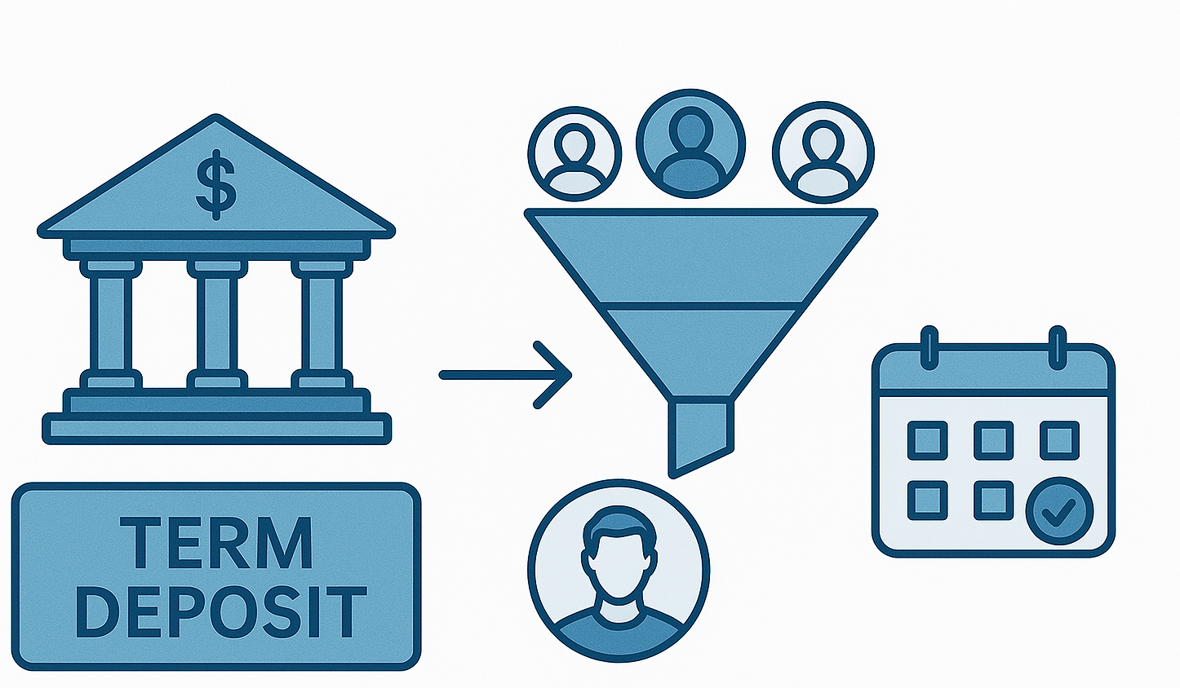
Introduction to Marketing
Marketing is the process of creating value for customers.
It focuses on building strong customer relationships.
The goal is to capture value in return, such as loyalty, engagement, and sales
Term Deposit
A fixed-sum deposit kept for a set maturity period
Higher interest rates but no early withdrawal
Marketing helps identify customers likely to invest in
such product

Slide 5
Challenges in Traditional Marketing
Low response rates
High cost of outreach
Difficulty identifying the right customers
Role of Data-Driven Marketing Machine learning enables targeted marketing, helping banks in a way ,
Predict customer behavior
Optimize resource allocation
Increase subscription rates
Instead of calling every customer, we now know who’s most likely to say yes

Slide 6
Dataset Overview
📁 UCI Machine Learning Repository, Kaggle (Bank Marketing Dataset)
📊 Dataset Size
🔢 45,000 records (rows)
📌 17 features (columns)
🧬 Feature Types
Categorical: job, marital, education, default, housing, loan..
Numerical: age, balance, duration, campaign, pdays, previous
Target Variable
y -> Did the client subscribe to a term deposit?
Yes
No

Slide 7
Overview of steps
Dataset creation
Data preprocessing
Training the dataset
Creating various supervised machine learning models
Selecting machine learning model based on the best score

Slide 8
Exploratory Data Analysis (EDA)
Univariate Analysis
Distribution plots for age, balance, duration
Count plots for categorical variables: job, education, marital status, loan, etc.
Bivariate Analysis
Relationship between features and target (y)
e.g., Subscription rate by job, education, housing loan, balance level

Slide 9
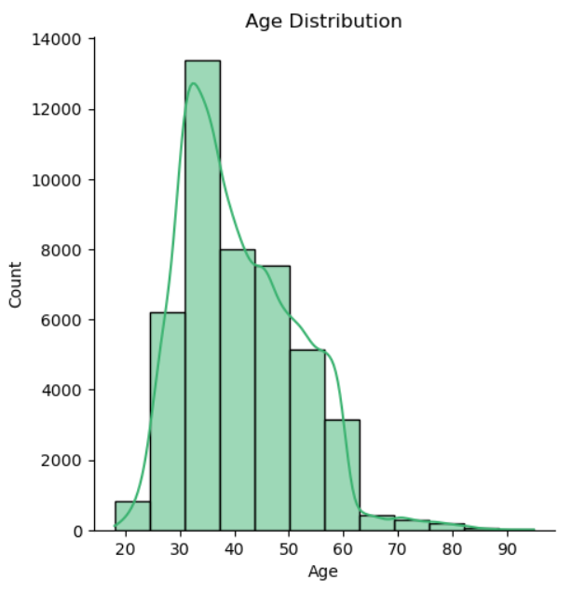
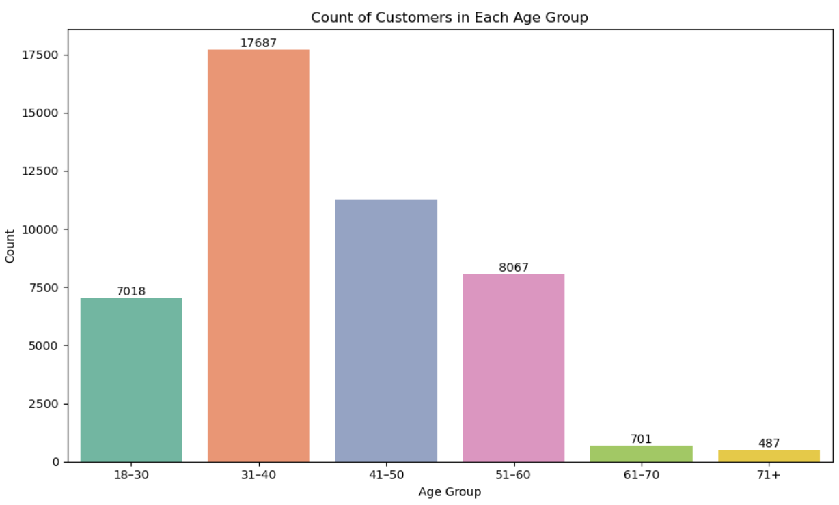
Based on customer Age

Slide 10
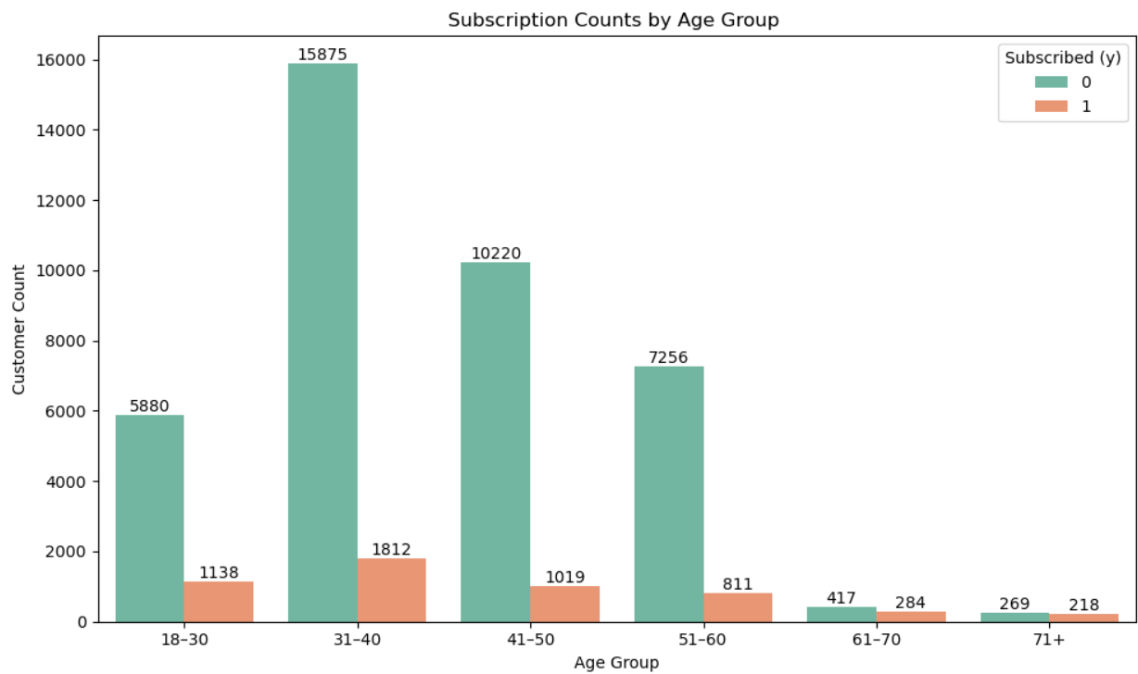

Slide 11
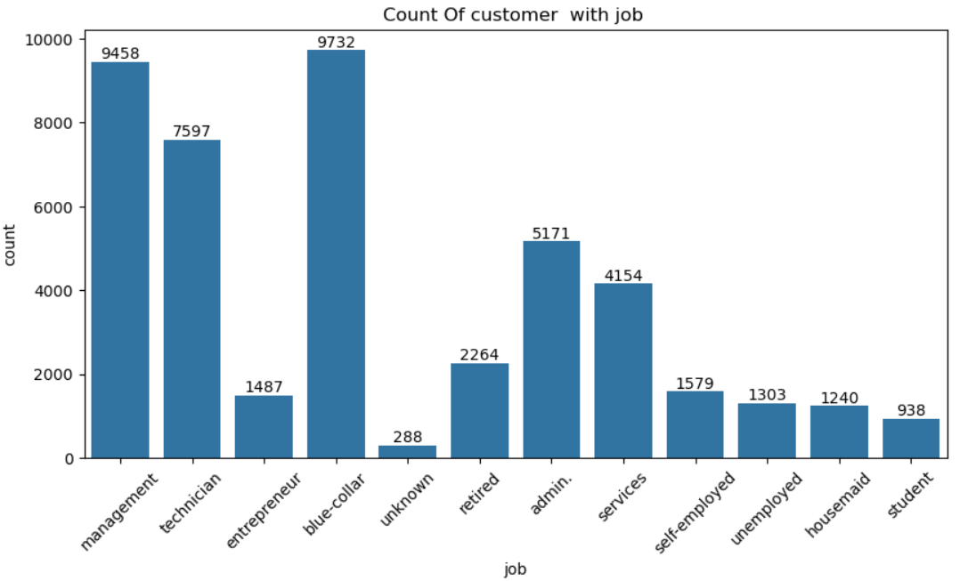
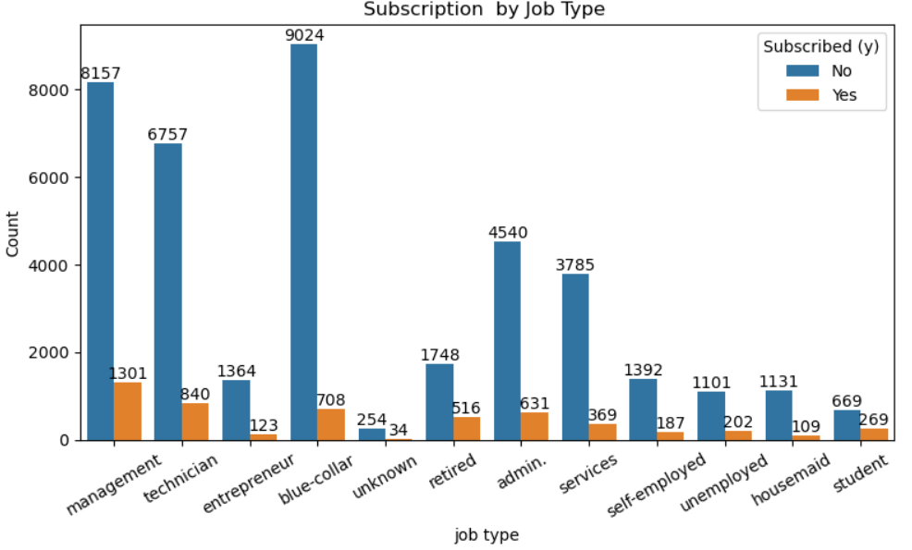
Based on job

Slide 12
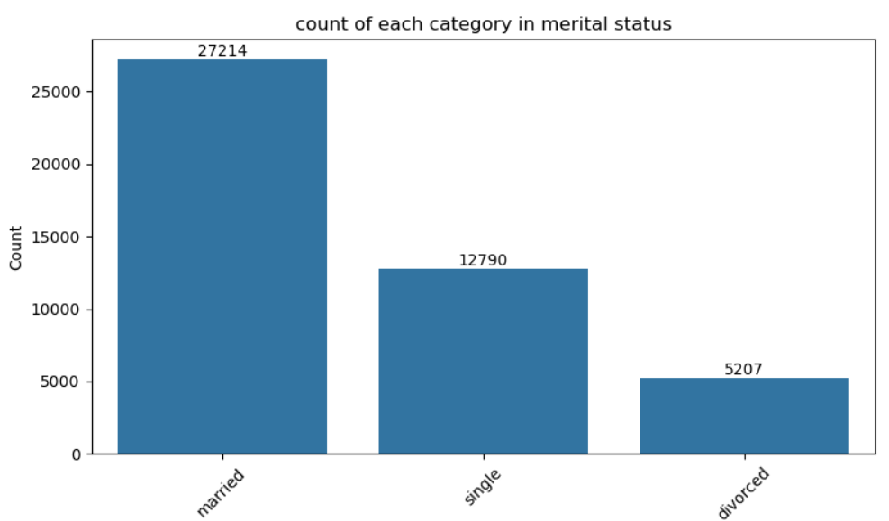
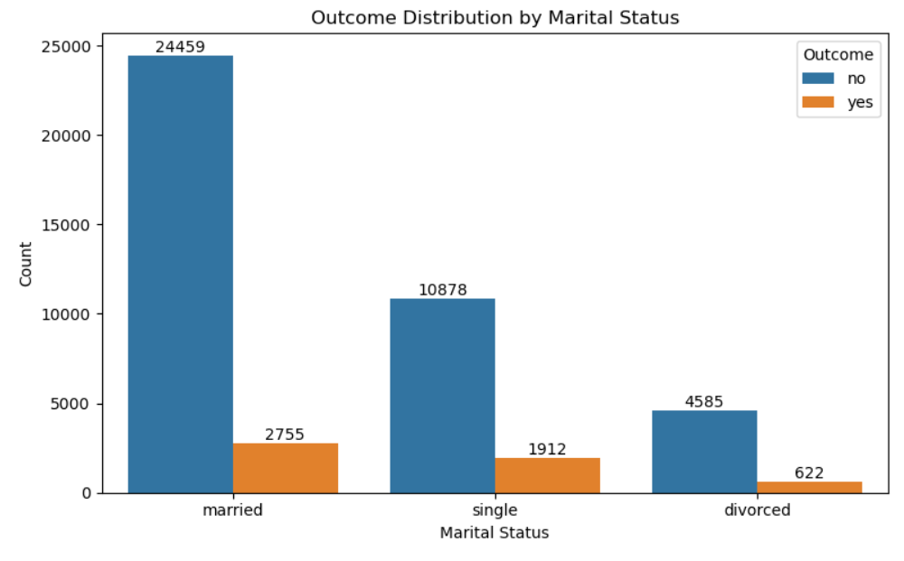
Marital Status

Slide 13
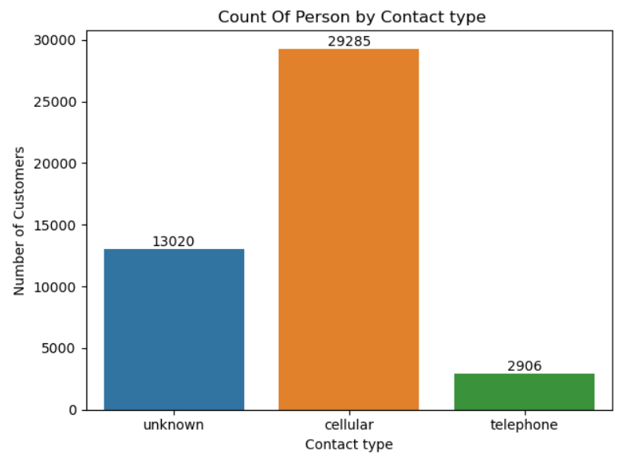
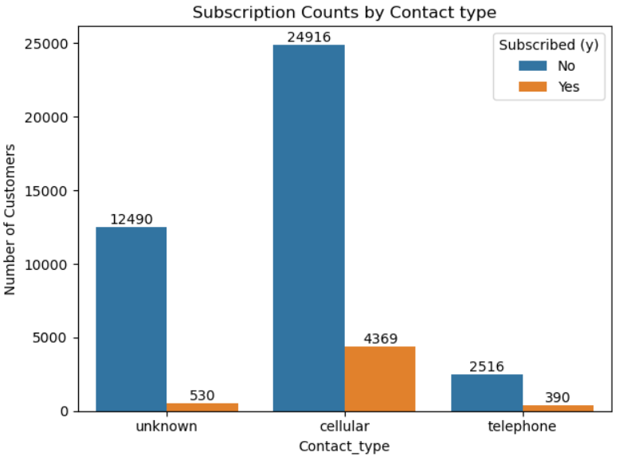
Contact type

Slide 14
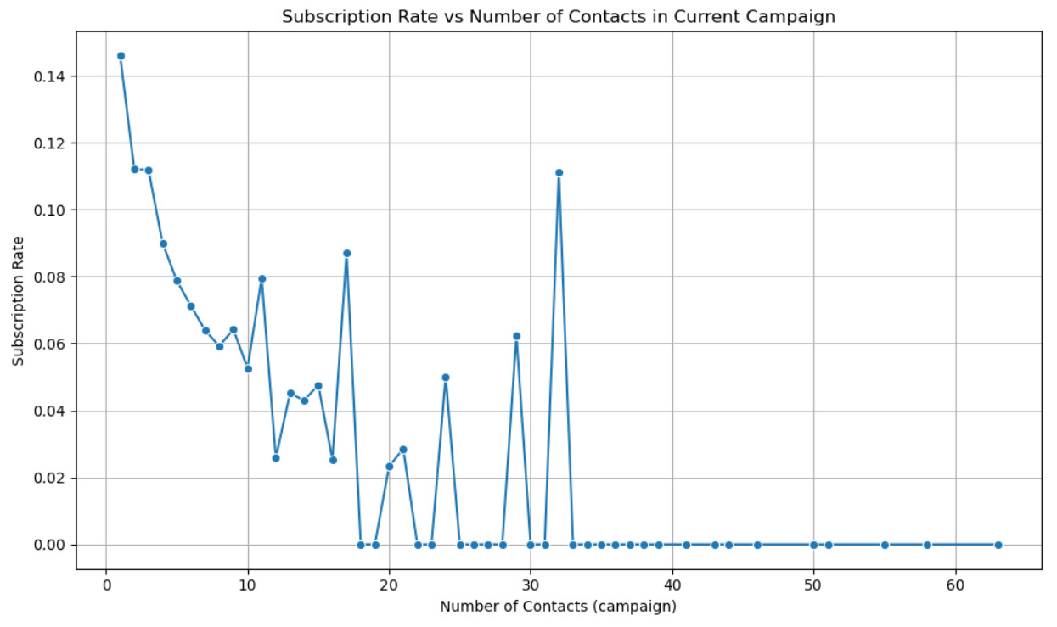
Number Of Contact
Optimal Range: Best results occur when clients are contacted 1 to 3 times — repeated follow-ups may lower interest
Marketing Strategy: Focus on making early contacts impactful rather than relying on frequent follow-ups.

Slide 15
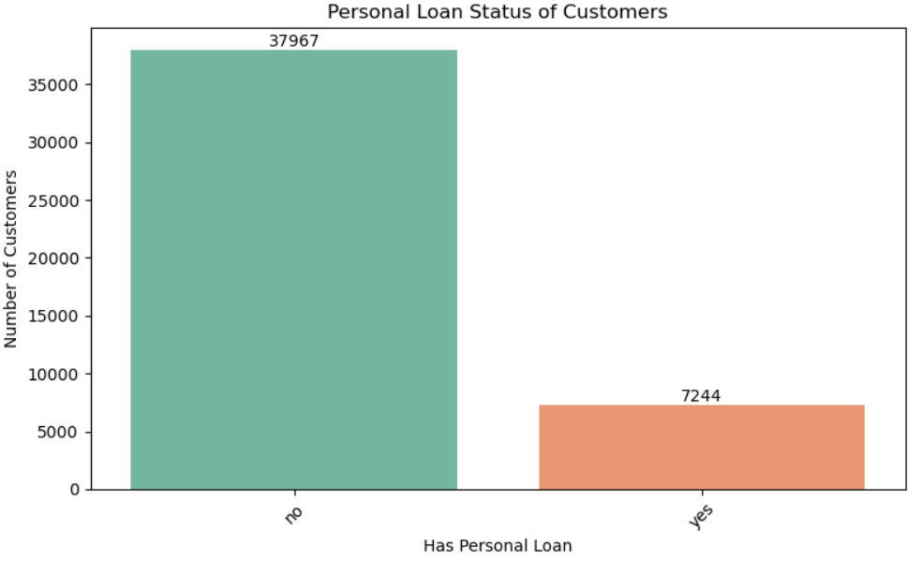
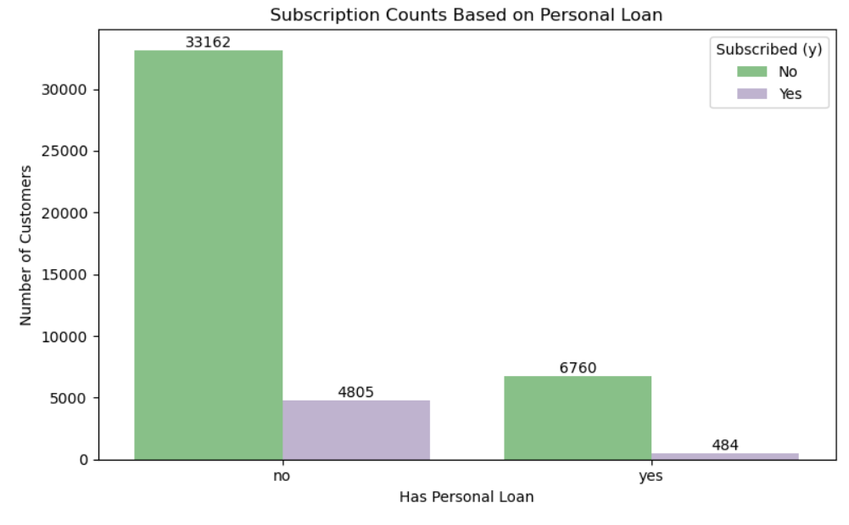
Personal Loan as Feature

Slide 16
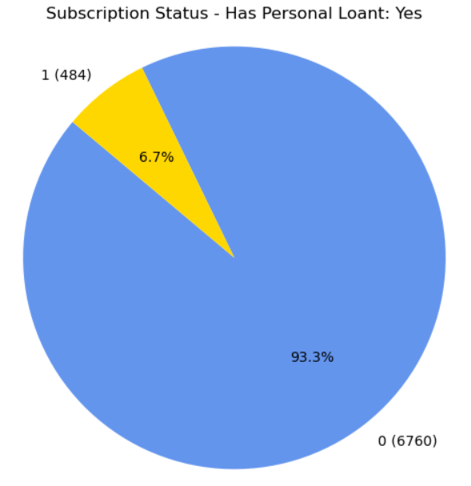
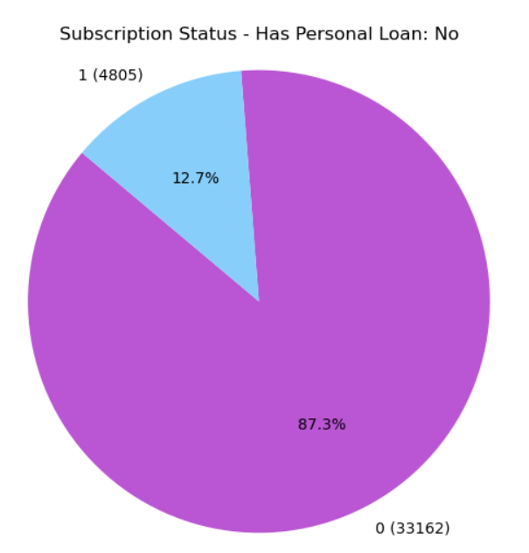

Slide 17
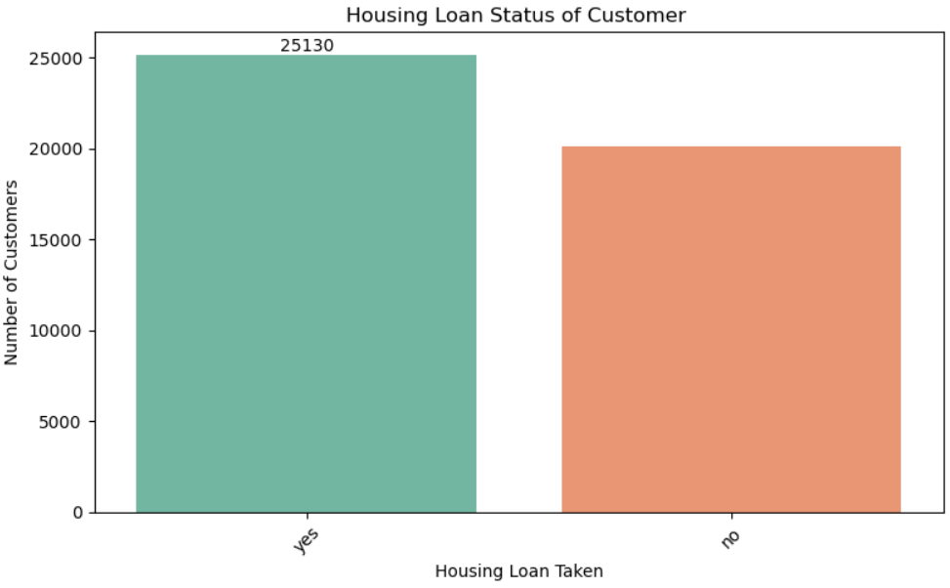
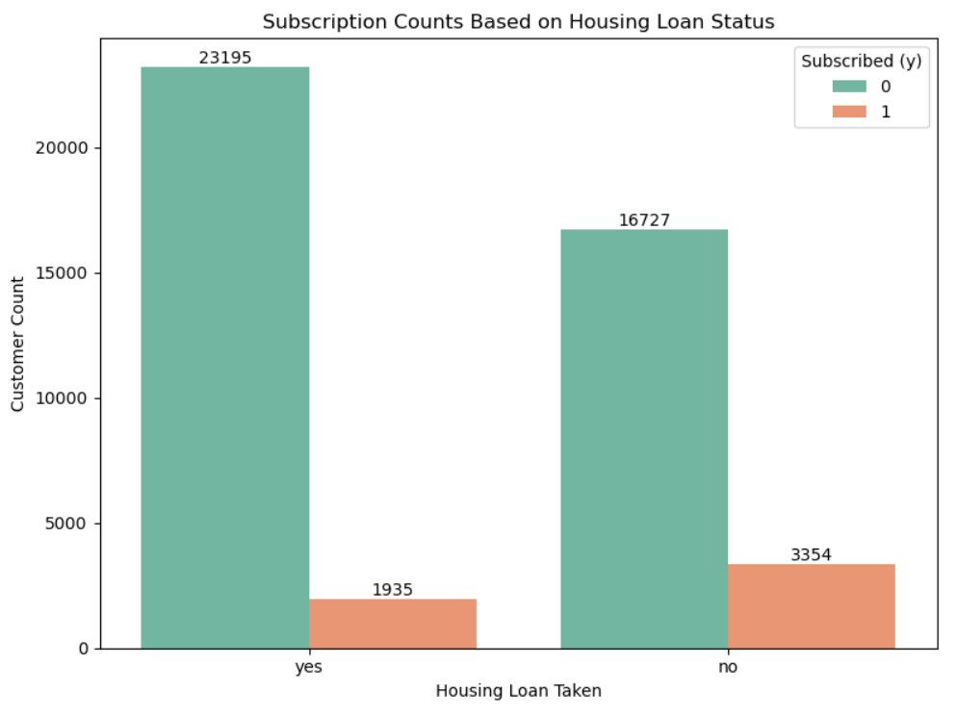
Housing Loan as Feature

Slide 18
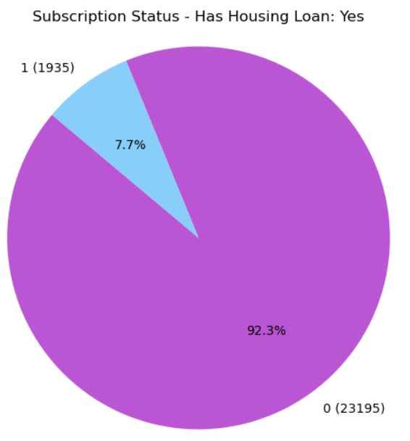
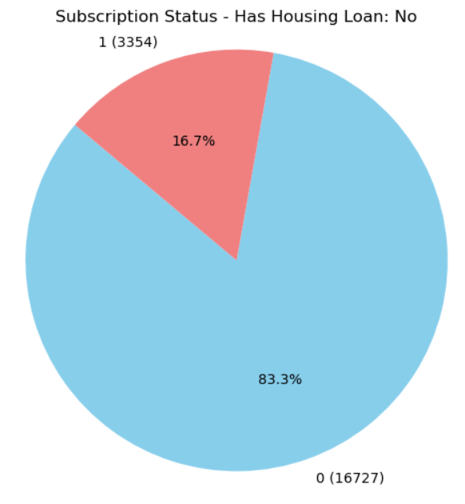

Slide 19
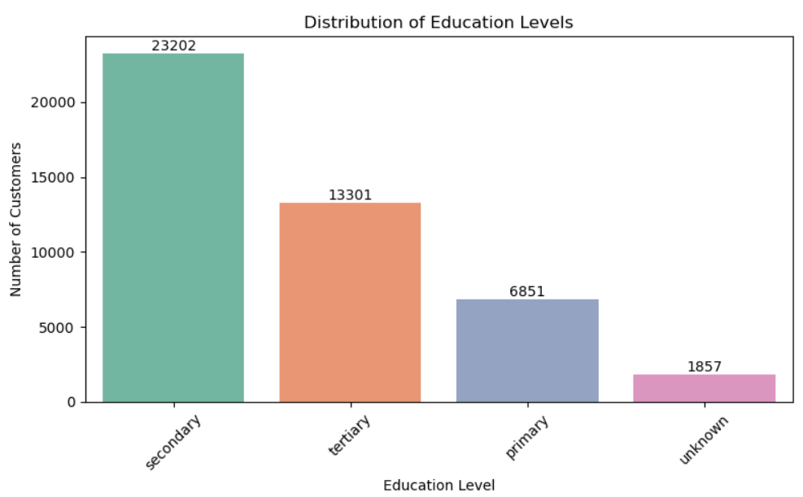
Education

Slide 20
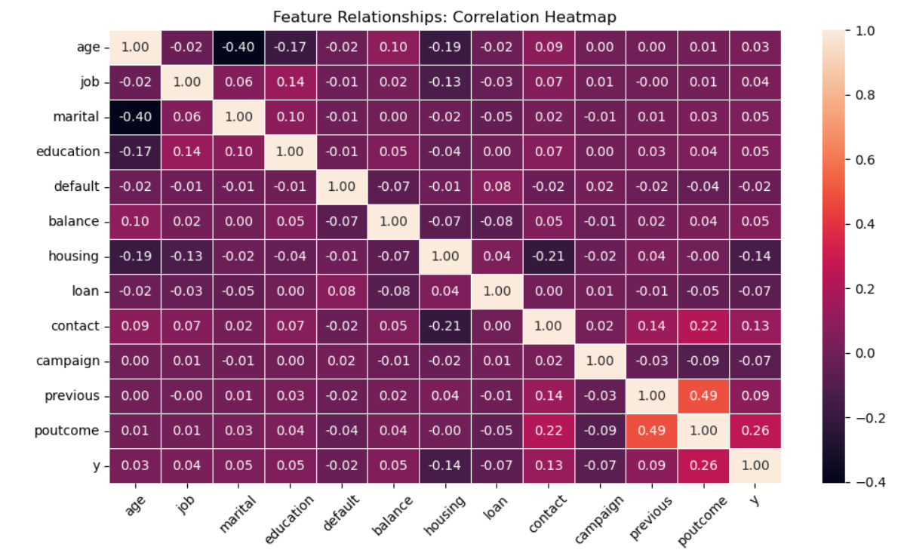

Slide 21
DATA PREPROCESSING
Data Cleaning: Handled missing values, and corrected inconsistencies.
Categorical Encoding: Transformed categorical features using methods like Label Encoding, Mapping.
Feature Scaling & Transformation: Normalized numerical features using MinMaxScaler and addressed outliers.
Dataset Splitting: Divided the data into training, validation, and test sets for robust model evaluation

Slide 22
Data Understanding: Peeking into the Data
The dataset serves as a historical record, encompassing attributes like age, job, marital status, and education, intertwined with campaign-specific details. At the heart of the dataset lies the binary target variable: did the client subscribe to a term deposit?
Visual explorations revealed distributions, tendencies, and outliers. For instance, we spotted patterns in job types and their propensity to subscribe.

Slide 23
METHODOLOGY
The project is developed in Python 3 using key libraries like NumPy for arrays, Pandas for data handling, and Matplotlib/Seaborn for visualization. Scikit-learn is used for implementing and tuning machine learning models. Data is managed in a DataFrame and manipulated using Python’s built-in structures and tools.

Slide 24
Business Understanding: Why Predict?
In the competitive world of banking, knowing what a customer might do next can make a big difference. By predicting how they’ll respond to marketing campaigns, banks can plan better, focus their efforts, and get more value from their work. Our goal is to find out if a customer will say yes to a term deposit when contacted.

Slide 25
The dataset was provided by the U. C. Irvine Machine Learning Repository and contained information on 41,188

Slide 26
—Data from a marketing campaign run by Banco de Portugal is examined. The campaign’s aim was to increase customers’ subscription rates to fixed-term deposit products, such as CDs. Using knowledge from the course, a number of machine learning algorithms are implemented to answer the question: How can banks successfully market these products in the most efficient way possible and with the highest possible rate of success

Slide 27
Data Preparation: Crafting Quality Data
Garbage in, garbage out! Quality data is paramount for insightful models. We undertook several steps:
Encoding: Life isn’t always numerical. Categories like job types were transformed into numbers using one-hot encoding.
Standardization: To place every feature on an equal footing, we centered them around zero and scaled them to have a unit variance.
Outlier Management: Extreme values can skew predictions. Techniques like the IQR ensured we kept anomalies in check.

Slide 28
. Modeling: The Prediction Engine
Models are the heartbeats of predictive analysis. We experimented with:
Logistic Regression: The classic prediction model.
Random Forest: An ensemble of decision trees working together.
Gradient Boosting: Boosting the weak learners to form a strong predictor.
Support Vector Machine: Finding the best hyperplane to differentiate classes.
Each model was trained, tested, and assessed. Metrics like accuracy, precision, recall, and F1 score painted a vivid picture of each model’s prowess.

Slide 29
CHOOSING A DATASET
Dataset was created by using python code and ChatGPT.
A python function was created to classify soil type based on the range of the feature values.
A python dictionary was created to define the soil type conditions.
For loop is then used to generate random values for each of the features and is stored into a list.
Then the list is converted to a dataframe.
The dataframe is saved to csv file.
Brief description-The dataset includes generated samples for different soil types, with each sample including values for organic carbon, pH level, soil color, drainage, and texture class. This structured data helps in analyzing and classifying soil types based on the given features.

Slide 30
Correlation with target 'y':
y | 1.000000
poutcome | 0.259315
contact | 0.130590
previous | 0.093236
balance | 0.052838
education | 0.051341
marital | 0.045588
job | 0.040438
age | 0.025155
default | -0.022419
loan | -0.068185
campaign | -0.073172
housing | -0.139173

Slide 31

DATA ANALYSIS TECHNIQUES
Techniques Used
Descriptive Statistics: Summary Statistics and Frequency Counts
Data Visualization: Histograms, Boxplots and Scatterplots.
Modelling
Classification Models:
Model Choice: Implemented models include Logistic Regression, Decision Trees, Random Forest, KNN,SVM, Naïve Bayes and Ensemble model Classifiers.
Training and Testing: Data split into training and test sets for model validation.

Slide 32
By looking at all the models that are created the best scores are obtained by the models are Decision Tree, Random Forest, KNN, Naïve Bayes, Gradient Boosting and XGBClassifier. The model we selected among these is Random Forest Classifier.

Slide 33
INSIGHTS AND RECOMMENDATION
Key Findings

Slide 34
SOLUTION IMPLEMENTATION

Slide 35
Impact:

Slide 36
Model | Model Score | After hyperparameter Tuning
Logistic Regression | 0.891798 | 0.892332
DecisionTreeClassifier | 0.825407 | 0.893134
RandomForestClassifier | 0.887791 | 0.895004
KNeighborsClassifier | 0.889661 | 0.891264
GaussianNB | 0.852792 | 0.891264
AdaBoostClassifier | 0.894603 | 0.895004
GradientBoostingClassifier | 0.894203 | 0.894603
XGBClassifier | 0.890863 | 0.894870
Support Vector Mechine-SVC | 0.892733 | 0.894203

Slide 37
Evaluation: Holding the Mirror
Models, like humans, aren’t perfect. Our star performer, the Support Vector Machine, shone in predicting clients who wouldn’t subscribe. However, it faced challenges in identifying potential subscribers. This dichotomy underscores the intricate nature of real-world data and the challenges it poses.
In practical terms, this means the bank might miss out on some potential subscribers but will be confident about those predicted not to subscribe. Depending on the bank’s goals (e.g., maximizing the number of subscribers or minimizing false positives), this model might be suitable or might need further enhancement.

Slide 38
Conclusion & Key Learnings
This project highlighted how banks can improve marketing strategies by:
Targeting prime-grade clients more effectively
Identifying favorable market conditions to boost term deposit subscriptions
We achieved this using data science and machine learning in Python, applying:
Tools like data frames, arrays, for loops, and more
Techniques from the Python for Data Science course
Our analysis and predictions demonstrated the power and practicality of Python in real-world data science applications

